Slide 1

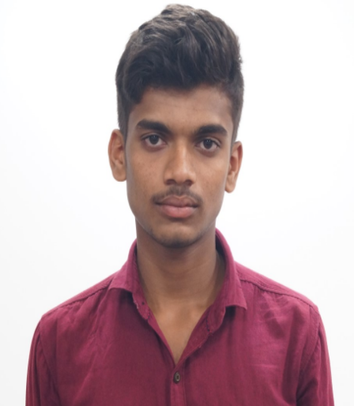
Student Profile
NAME: Toogu Ganesh Kumar Reddy
REGISTRATION NUMBER: 192011460
COURSE CODE: CSA4354
COURSE NAME: Internet Programming PROJECT TITLE: Advance Booking System For two
wheelers and four wheelers
PHOTO

Slide 2
ABSTRACT: A open source advance booking site for two wheelers and four wheelers for user’s unexpected and instant road trips.
INTRODUCTION: User can directly access the site using site’s URL, User should read all the
instructions needed for the booking process from “Read me” content.
User can choose his renting and returning date and timings and proceed for
vehicle availability, once he found convenient vehicle for his trip, further can
proceed for user details and payment as well.
MODULES: .html to run made the structure of the web pages,
.css to made the structured web page by .html more colourful and user attractable
.php to made the server connection to fetch the vehicle data and to store user
personal data and bookings payment details
.sql for queries that fetch for the vehicle availability and to insert data into
database tables.

Slide 3
WORKING PRINCIPLES: 1. Direct access to website for any users active in good internet connection 2. User should read the “Read me” prompt to get an overview of booking process. 3. User can choose date and timings and vehicle type for his planned trip and check for vehicle availabilities. 4. Once user choose his vehicle, need to proceed for the document and personal data verification by company terms and conditions.(licence is mandatory). 5. Once user verified all his documents and can proceed for payments, all types of card payments are available and allowed. 6. User can view his booking success message on the console once all the payment activities are done and verified successfully.

Slide 4
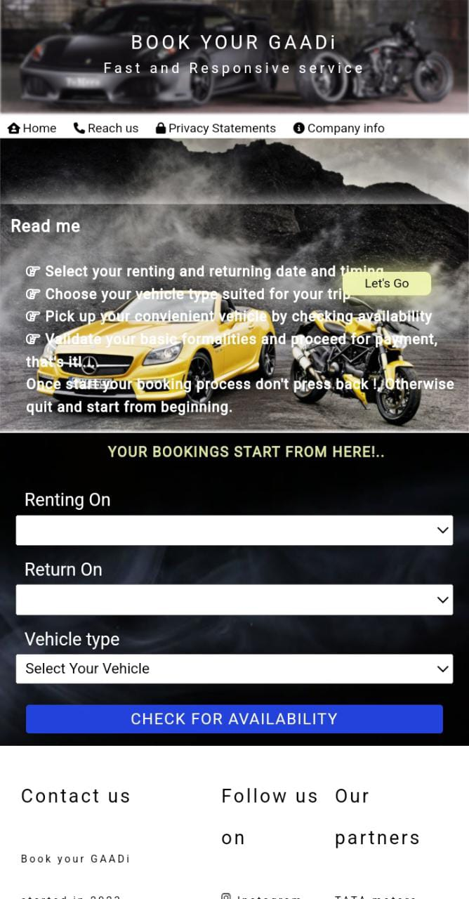
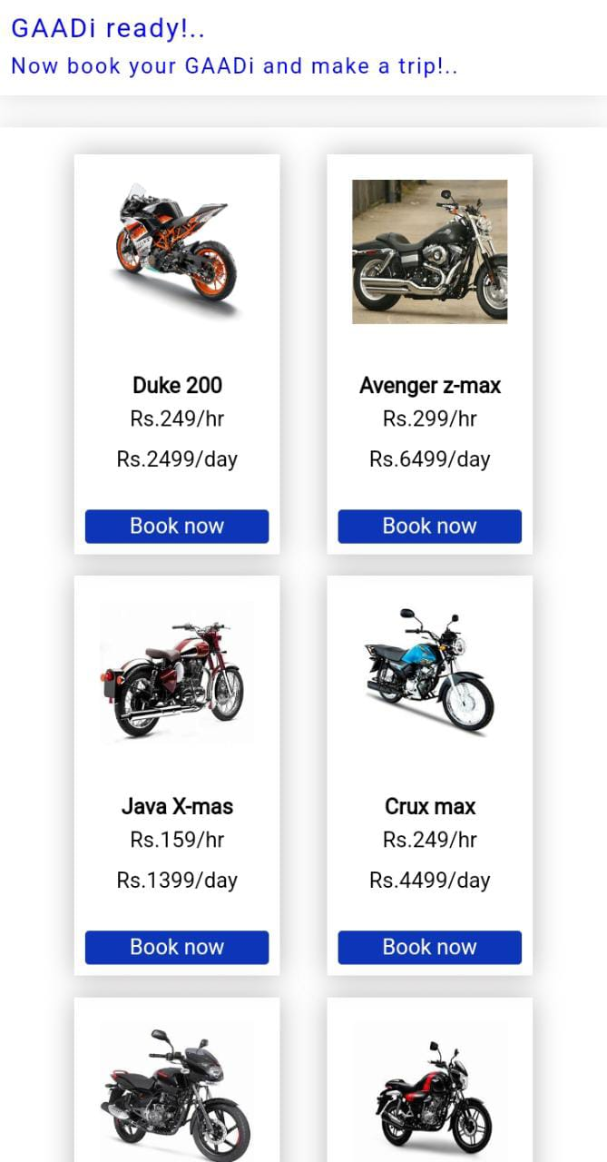
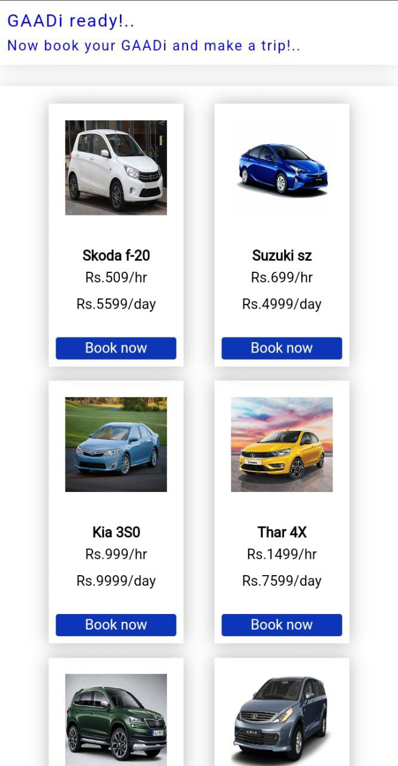
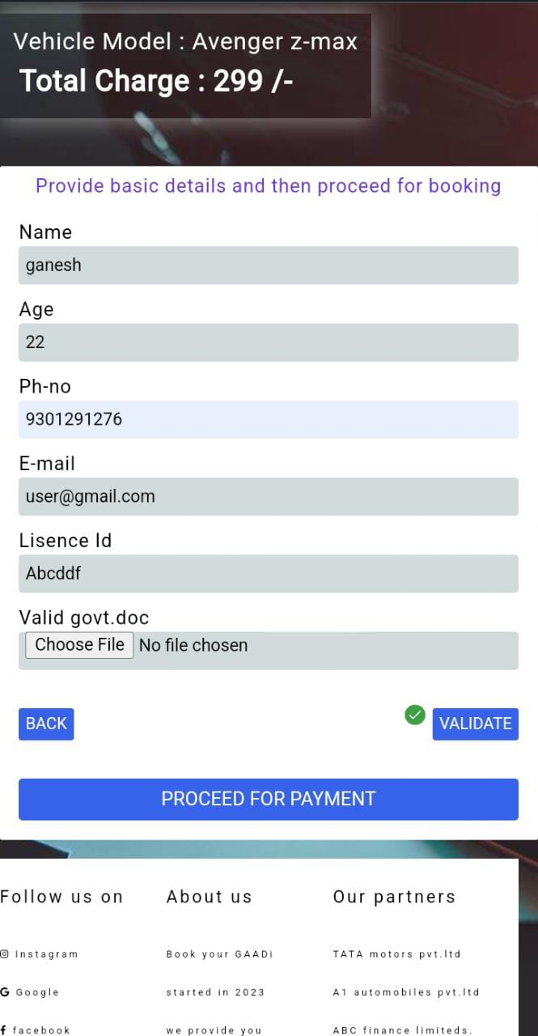
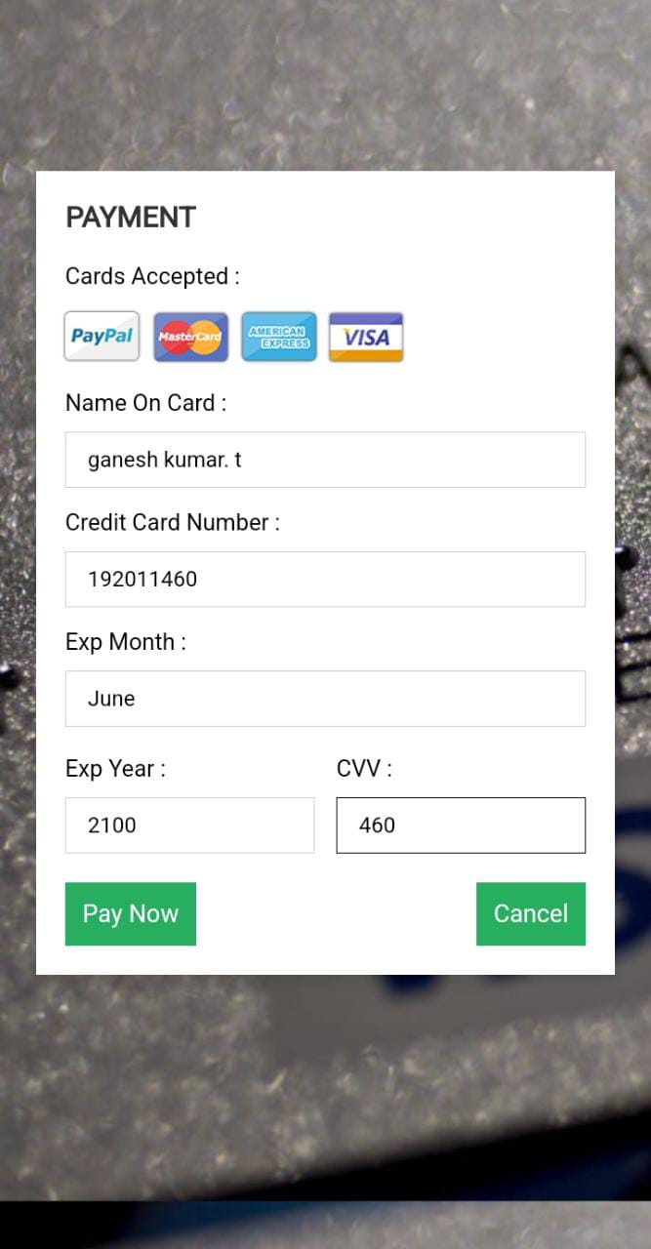
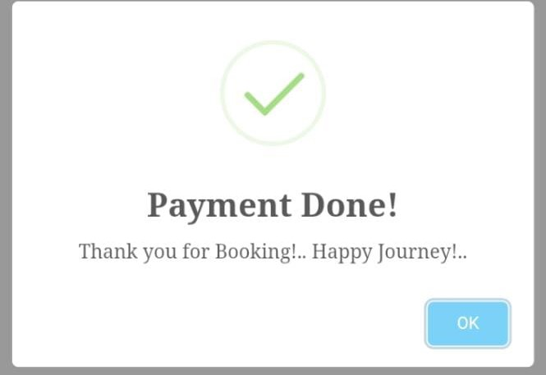
PICTORICAL EXPLANATION :

Slide 5
OUTPUT : Now user can book their convenient vehicles needed for their planned trips in a easy and simple way with in couple of minutes.
CONCLUSION: Instead of visiting rental showrooms, It came with better choice to visit the site
and book vehicles availability on user specified dates and timings.
FUTURE UPGRADATION: 1. Penalty on the improper vehicle returning timings.
2. Chance to extend user trip duration by informing reason to the technical team
using user’s unique id until another user’s renting time travel if he already
booked the same vehicle.
3. Displaying time duration on each vehicle image when it is getting free from all
bookings.
4. Sending confirmation and remainders to user’s mobile no. and mail id.
5. Payment refund activities.

